Slide 1

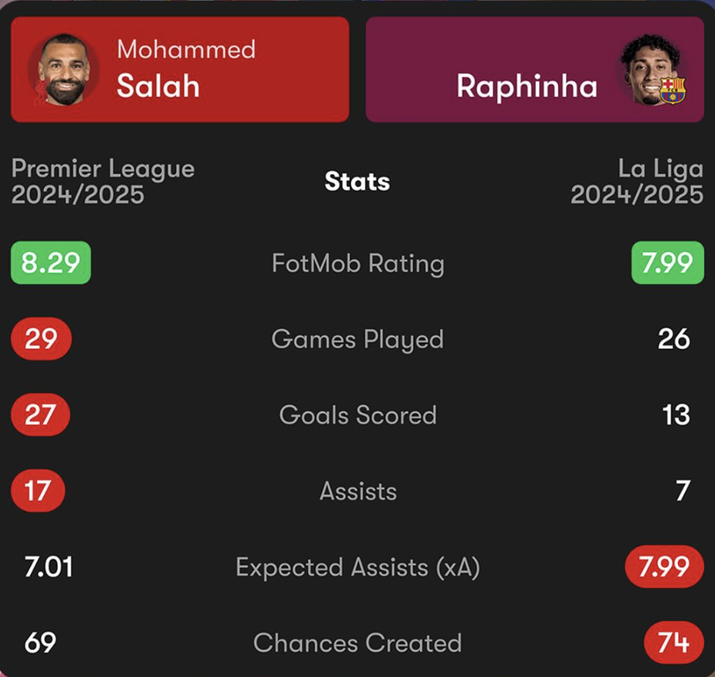
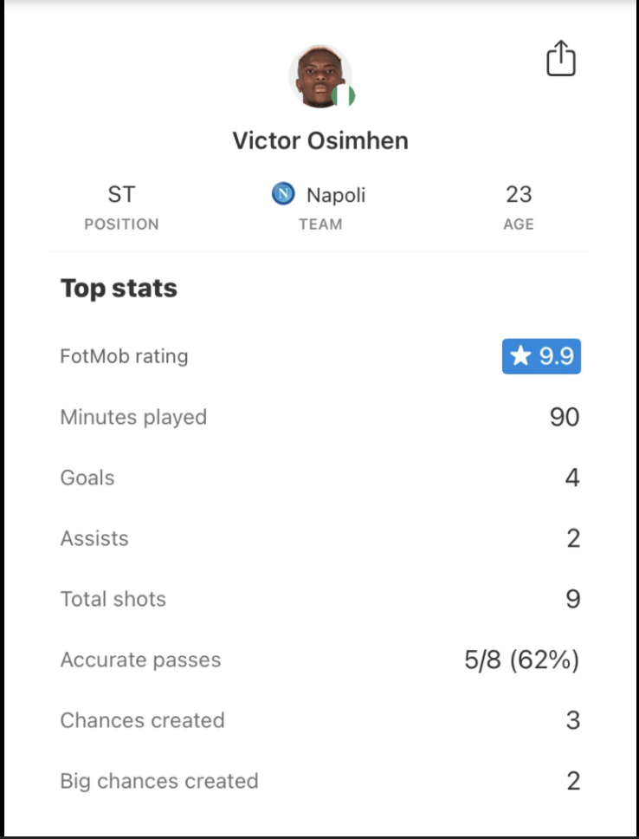
Smart Soccer Analyzer by: Abemelake Kebede and Joven Heynes
Tag Line: Track. Compare. Analyze. The Full Picture of European Football.
This project aims to track and store the detailed statistics for any players playing in Europe's 5 premier leagues which include Premier League, La Liga, Serie A, Bundesliga, and Ligue 1. Our goal in the project is so that when you input a players name, their advanced statistics show up giving us a look at their performance for the season. These stats consist of thing such as goals, assists, appearances, passing accuracy, defensive actions, and more—offering a centralized resource for performance insights. If successfully ran, the code will have a feature where you can look up your favorite players and their corresponding stats will follow up.

